Slide 1

THE IMPACT OF COVID-19 ON THE GLOBAL ECONOMY.
……………………………………………………………………………..

Slide 3
INTRODUCTION
Description : The COVID-19 pandemic tossed the world into a state of uncertainty, not only from the health standpoint but also on global economy. With the global that were enacted requiring many businesses to shut down early and limiting the number of people engaged in gathering activities, this took a toll on the level of consumption and total output that builds a country’s economy. Our interest in this topic pertains to our willingness to explore the different ways and to what degree ecological forces like the global COVID-19 pandemic can affect a country’s economy both short and long term.

Slide 4
QUESTIONS THE TEAM HOPES TO ANSWER WITH THE DATA.
Which countries were most and least affected by COVID-19?
What income group the countries affected fall into?
Is GDP per capital a determinant of cross-country differentials in impact of COVID-19?
Is HDI a determinant of cross-country differentials in impact of COVID-19?
Is population size a determinant of cross-country differentials in impact of COVID-19?

Slide 5
CCC
PS: Which countries were most and least affected by COVID-19?
The top ten most and least affected countries based on the total cases and total death are as shown below:

Slide 6
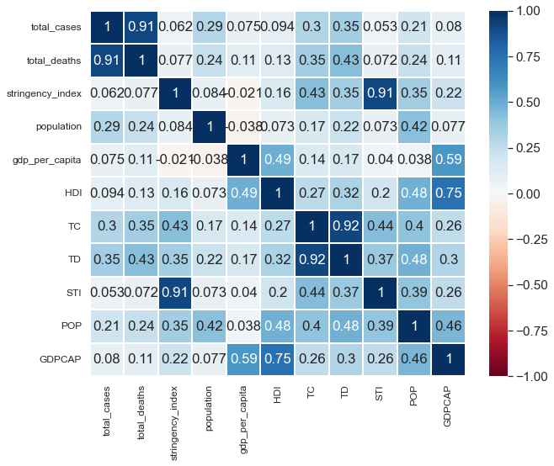
Correlation Analysis Chart

Slide 7
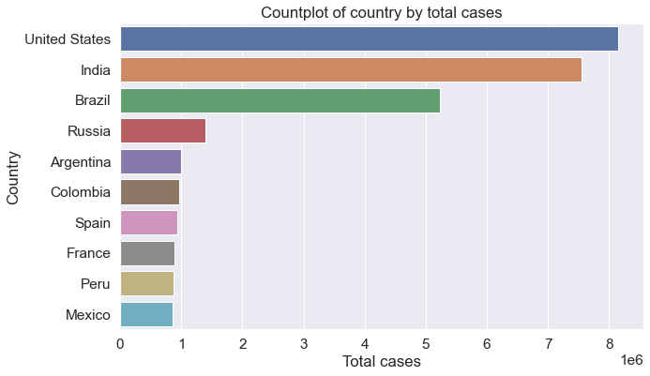
Top Ten Most Affected Countries by Total Cases

Slide 8
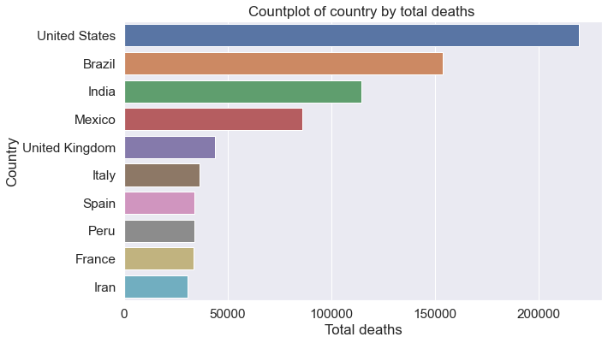
Top Ten Most Affected Countries by Total Deaths

Slide 9
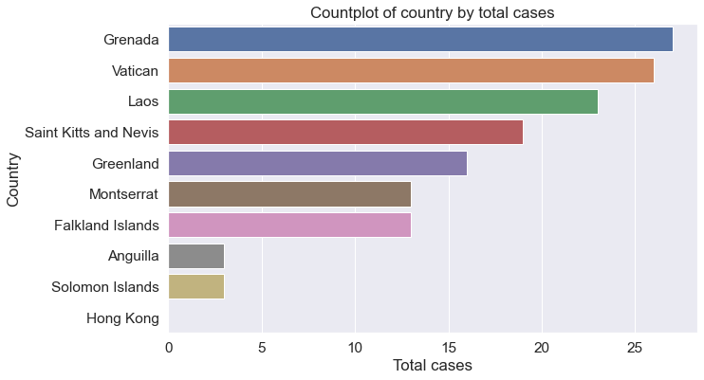
Top Ten Least Affected Countries by Total Cases

Slide 10
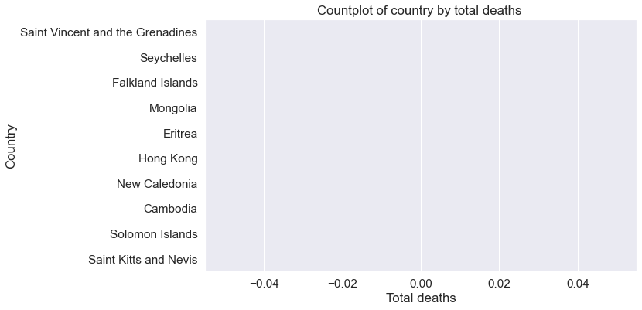
Top Ten Least Affected Countries by Total Deaths

Slide 11
CCC
PS: What income group the countries affected fall into?
The countries were grouped based on the GNI per capita and their counts were taken as shown below:

Slide 12
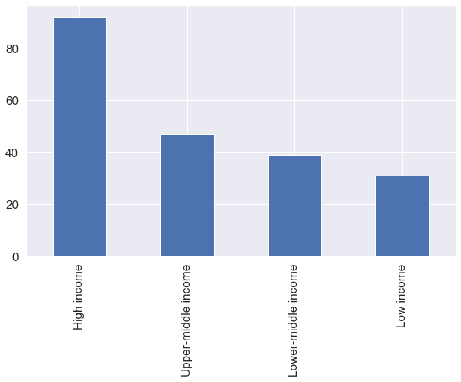
Graph showing the value count of the income groups

Slide 13
CCC
PS: Is GDP per capital a determinant of cross-country differentials in impact of COVID-19?
GDP per capita produces slight changes across the countries as shown below:

Slide 14
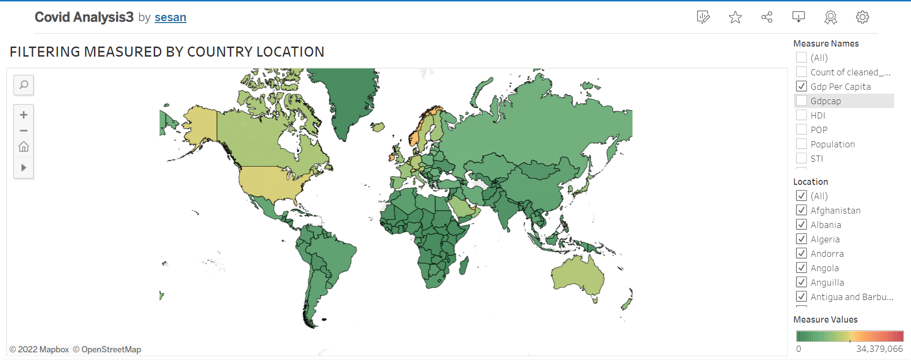
Map showing changes by GDP per capita

Slide 15
CCC
PS: Is HDI a determinant of cross-country differentials in impact of COVID-19?
HDI produces major changes across the countries as shown below:

Slide 16
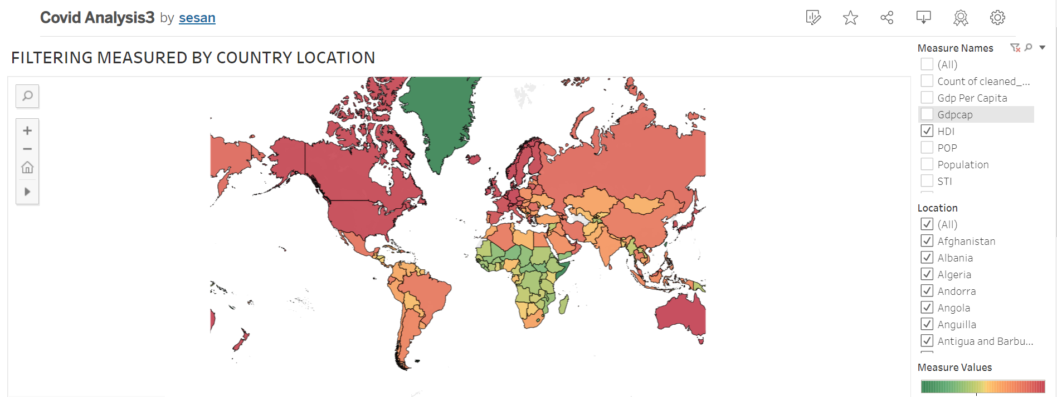
Map showing changes by HDI

Slide 17
CCC
PS: Is population size a determinant of cross-country differentials in impact of COVID-19?
Population size was greatly affected by the COVID-19 across the countries as shown below:

Slide 18
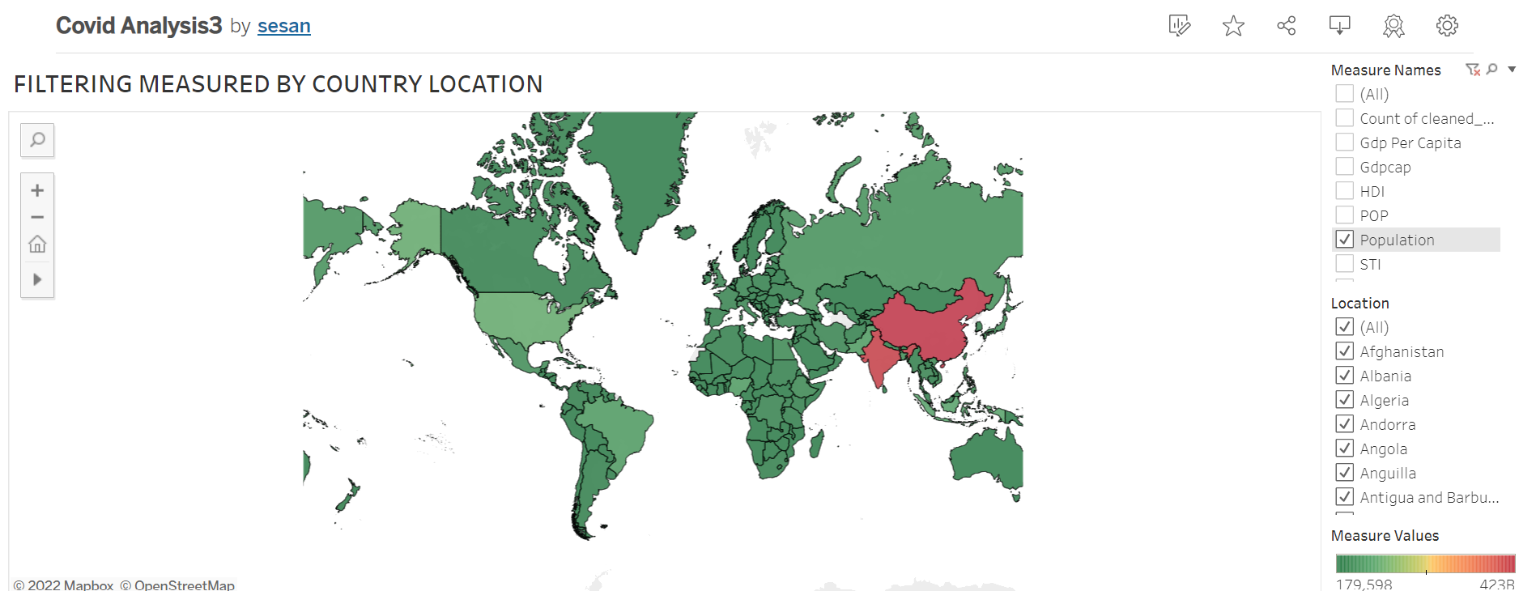
Map showing changes by Population size

Slide 19
MACHINE LEARNING
We used supervised learning in analysis this data using linear regression.
Linear regression is typically used in predicting, forecasting, and finding relationships between quantitative data.
Regression models a target prediction value based on independent variables. In our analysis the independent variables were; stringency index, population and GDP per capita predicting total cases.
We used supervised machine learning as it allows for the discovery of insights to better understand relationships and patterns within a labeled training data set.
Herem we do have a labeled training data set already containing the known value, or answer, for the target variable of each record.

Slide 20
Using Machine Learning to identify the most significant variable that can be used to predict total cases
To see how variables affect the number of cases. we drop total_deaths variable due to its high correlation to the total_cases variable.
The most relevant features, are those that influence the predictor variable, total_cases, the most.
We first remove non-numeric variables; which is dropping; iso_code, location and date.
We then drop the predictor variable from the dataset.
Next is to convert the pandas dataframe to a numpy array; to enable computation and then normalize the data.
The final step is creating the linear regression model and checking for feature imprtance.
This concludes that stringency index is the highest predictor for total cases and thus total deaths.

Slide 21
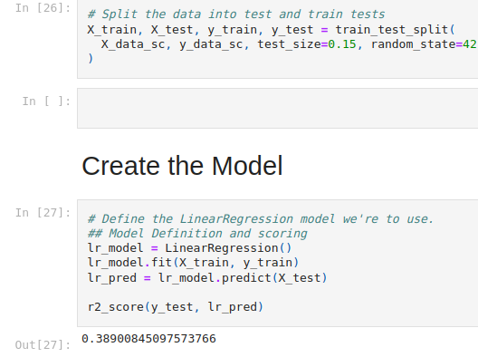

Slide 22
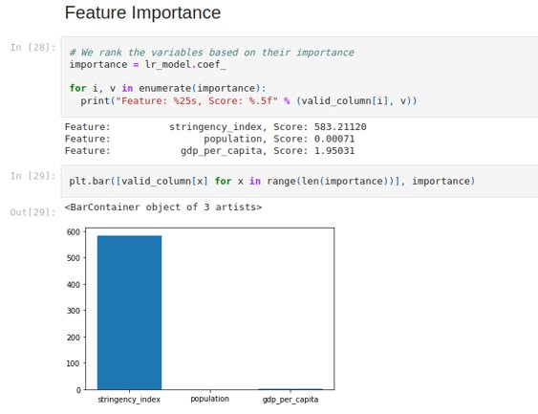

Slide 23
CONCLUSION
As seen in the analysis, the COVID-19 pandemic had a great impact on the world’s economy in negative ways. The maps and the charts also showed how the pandemic affected the GDP per capita, HDI and the population size generally.
However , in the final stage of the project the following softwares would be used to analyse and create our dashboard, viz:
1, Tableau
2. Python/Pandas

Slide 24
Thank You!

